Slide 1


Center For Career Opportunities
Peer Consultant
2016-2017
Paid Position
8-10hrs/week
Learn More at Callouts
Jan. 19th @ 6:30 pm | PHYS 203
Jan. 20th @ 6:30 PM | Phys 203
Apply to be a Peer Consultant on myCCO with Job ID #798282
*Students who can confirm financial need are encouraged to apply

Slide 2
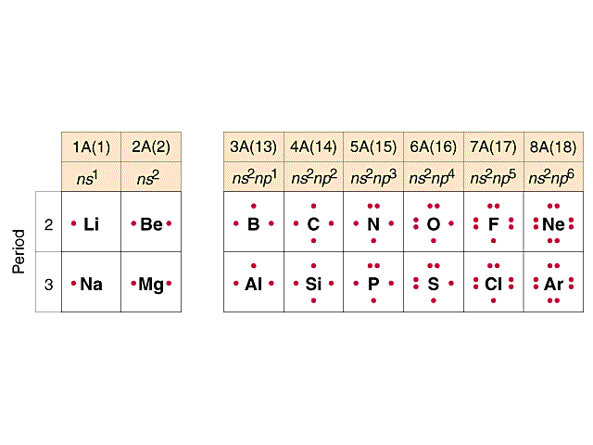
Lecture 3: Bonding in chemical compounds
Lewis electron-dot structures
Number of dots = number of valence electrons

Slide 3
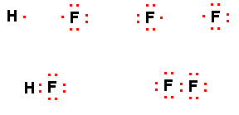
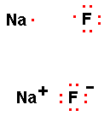
Transferring electrons creates ionic compounds:
Sharing electrons creates covalent compounds:
Non-bonding electrons
Lone pairs
Closed shells
Bonding pairs
Coulombic attraction

Slide 4
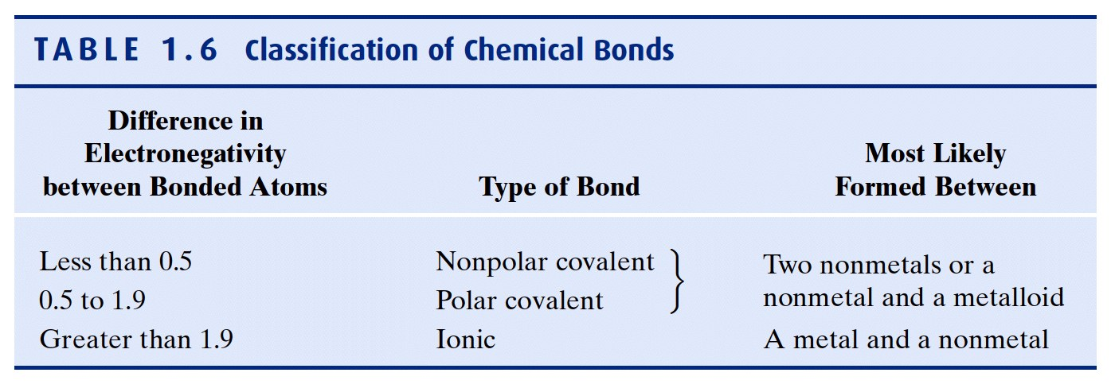
Which type of bonding occurs depends on the electronegativities of the elements = measure of the force of an atom’s attraction for electrons it shares in a chemical bond with another atom
NOTE: Sapling homework uses 1.7 as the border between covalent
and ionic bond!

Slide 5
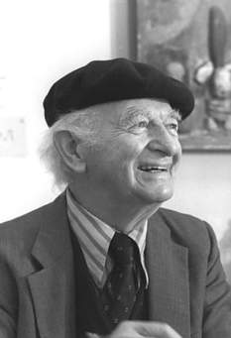
Linus Pauling 1901 – 1994
Caltech
Noble Prize in Chemistry: 1954
Noble Peace Prize: 1962
Most commonly used
electronegativity scale (1930’s):
F: 4.0; most electronegative atom
Notes:
Vitamin C; only person ever to get two unshared Noble Prizes

Slide 6
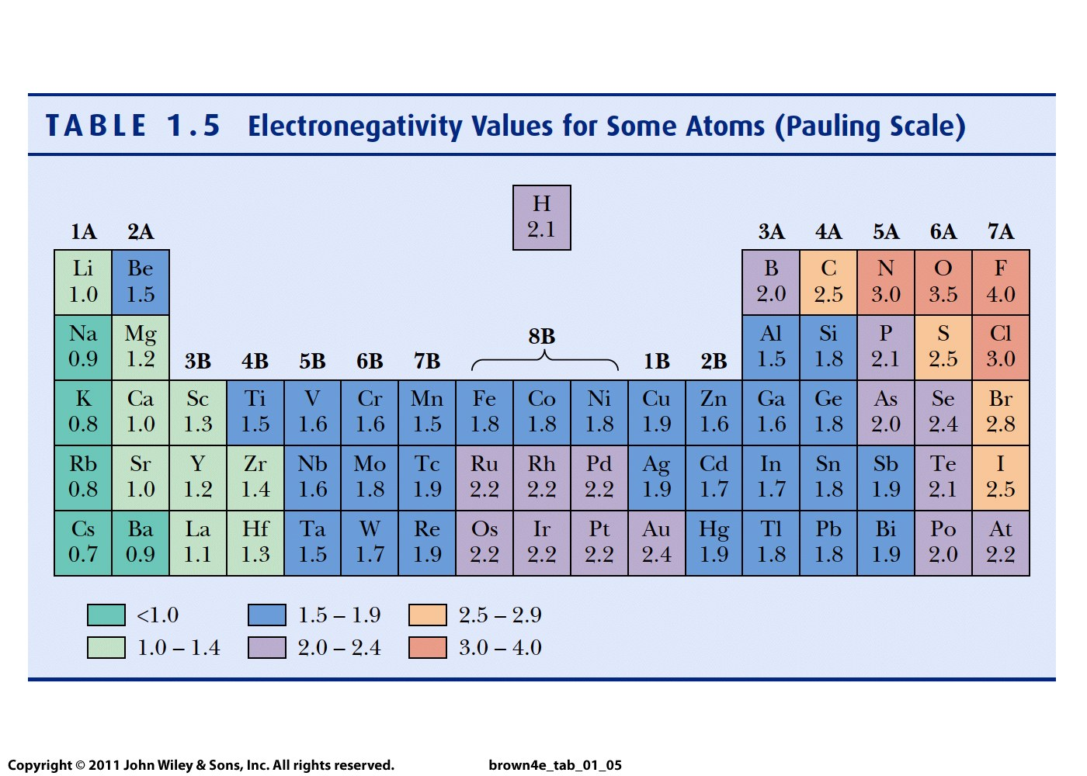

Slide 7

Ionic bond
e transfer occurs from the atom of lower electronegativity
to the atom with greater electronegativity

Slide 8
Lewis electron-dot structures
For metals, number of dots = number of electrons it loses
What is the Lewis structure for Ca?
How many electrons does it tend to lose?
For non-metals, the number of dots reveals the number of electrons it can receive or share to achieve an octet
What is the Lewis structure of O?
How many electrons does it tend to gain?
..
..
● Mg ● → Mg ²⁺ + 2 e⁻
..
..
..
●
..
●
●
●
O + 2e⁻ → O ²⁻
..
●
●
..
●
●
●
●
●
●
●
●

Slide 9
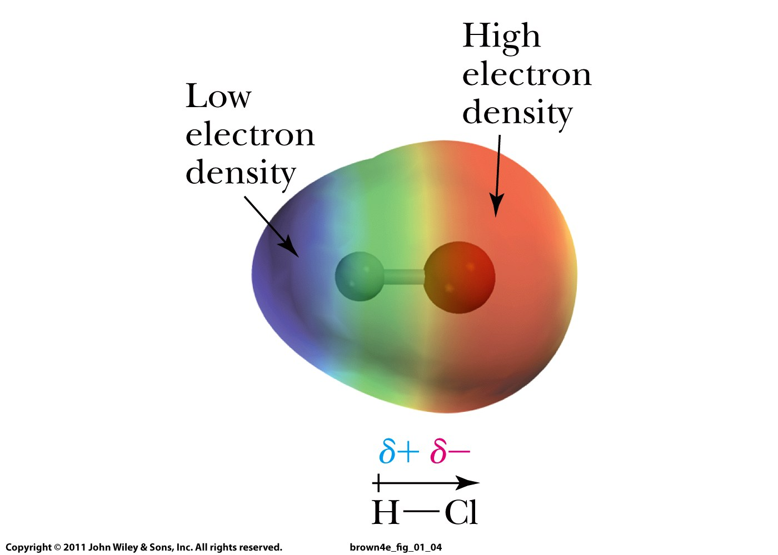

Slide 10
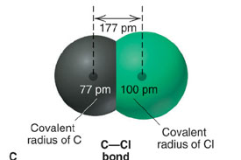
Covalent bond’s length from distances between atoms
Smaller length = stronger bond

Slide 11
Lewis electron-dot structures
8 - number of dots = number of covalent bonds
that nonmetals form

Slide 12
Lewis structures of molecules
the atoms in a molecule (or covalent ion)
what atoms are bound to each other
the location and type of bonds
the location and number of lone pairs
formal charge of each atom

Slide 13
A Stepwise Method for Drawing Lewis Structures of Molecules

Slide 14
Lewis Structures
NOCl
1. Choose the central atom (forms most bonds)
2. Draw bonds to other atoms
3. Count valence electrons
4. Count the remaining electrons
5. Distribute them as lone pairs and/or multiple bonds
6. Verify that all atoms have 8 electrons

Slide 15
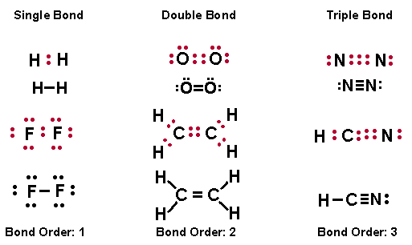
Multiple Bonds
Commonly, double and triple bonds are limited to C, O, and N.
In addition, P, S, and Se may form double or triple bonds

